Slide 1

CHINOOK MUSIC STORE ANALYSIS
SYNCHRONIZING SUCCESS THROUGH DATA
ARITRA KHANRA

Slide 2

ABOUT CHINOOK MUSIC
Founded in 1995, Chinook Music Service has grown to become a trusted name in North Central Washington for quality musical instruments, accessories, rentals, and professional repairs.
Our dedicated team of music specialists and educators is passionate about helping musicians of all levels—from school bands to touring artists—find the right gear and support they need.
We proudly partner with local schools, music programs, and performers, offering reliable rentals and maintenance services to keep the music playing.
For more information : https://chinookmusic.com/

Slide 3

OBJECTIVE
Examine customer behavior with respect to their locations, spending habits, and purchase trends.
Find patterns by examining which tracks, albums, genres, and artists are most popular and frequently bought.
Use sales data from various regions to understand trends and improve product targeting and marketing strategies.
Review product sales data to support efforts for cross-selling and providing useful recommendations.
Deliver actionable suggestions for supporting business expansion and enhancing customer interactions.

Slide 4
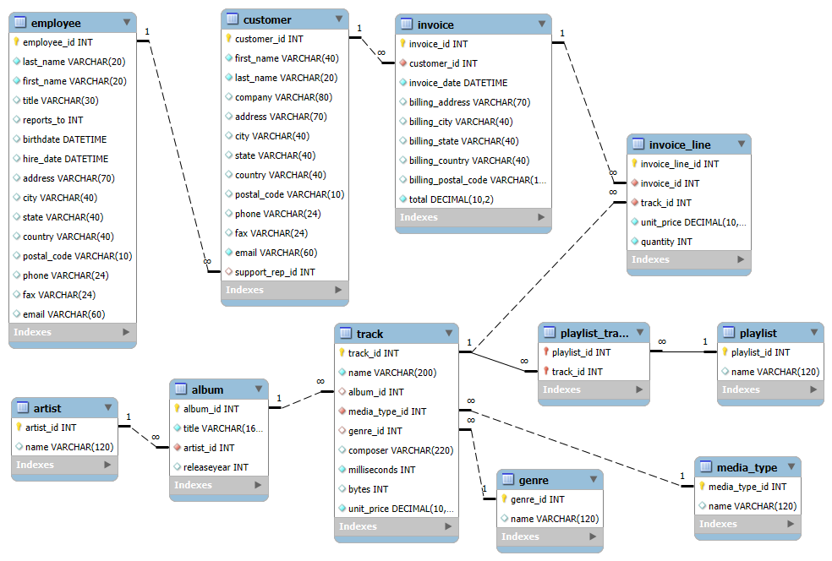
DATABASE SCHEMA

Slide 5
DATA OVERVIEW
artist:
artist_id: Unique identifier assigned to each artist.
name: The name of the artist or band.
album:
album_id: Unique identifier assigned to each album.
title: The title of the album.
artist_id: The ID of the artist who created the album.
track:
track_id: Unique identifier assigned to each track or song.
name: The title of the track.
album_id: The album ID to which the track belongs.
media_type_id: The ID indicating the media type format of the track (e.g., MP3).
genre_id: The ID indicating the genre of the track.
composer: The name of the person(s) who composed the track.
milliseconds: Duration of the track in milliseconds.
bytes: The file size of the track in bytes.
unit_price: The price of the track.
media_type:
media_type_id: Unique identifier assigned to each media type.
name: The name or format of the media.
genre:
genre_id: Unique identifier assigned to each genre.
name: The name of the music genre (e.g., Rock, Jazz, Classical).
playlist_track:
playlist_id: The ID of the playlist to which the track belongs.
track_id: The ID of the track included in the playlist.
playlist:
playlist_id: Unique identifier assigned to each playlist.
name: The name of the playlist.

Slide 6
DATA OVERVIEW
customer:
customer_id: Unique identifier assigned to each customer.
first_name: The given name or first name of a customer.
last_name: The surname or family name of a customer.
company: The name of the company associated with a customer.
address: The street address of a customer's location.
city: The city where a customer is located.
state: The state or province where a customer is located.
country: The country where a customer is located.
postal_code: The postal or zip code of a customer's address.
phone: The phone number of a customer.
fax: The fax number associated with a customer.
email: The email address of a customer.
support_rep_id: The employee ID of the support representative assigned to a customer.
employee:
employee_id: Unique identifier assigned to each employee.
last_name: The surname or family name of an employee.
first_name: The given name or first name of an employee.
title: The job title or role of the employee.
reports_to: The ID of the employee’s manager.
birthdate: The birth date of the employee.
hire_date: The date the employee was hired.
address: The street address of the employee.
city: The city where the employee resides.
state: The state or province where the employee resides.
country: The country where the employee resides.
postal_code: The postal or zip code of the employee’s address.
phone: The phone number of the employee.
fax: The fax number of the employee.
email: The email address of the employee.

Slide 7
DATA OVERVIEW
invoice:
invoice_id: Unique identifier assigned to each invoice.
customer_id: The ID of the customer who made the purchase.
invoice_date: The date when the invoice was created.
billing_address: The billing street address.
billing_city: The city associated with the billing address.
billing_state: The state or province associated with the billing address.
billing_country: The country associated with the billing address.
billing_postal_code: The postal or zip code of the billing address.
total: The total amount billed on the invoice.
invoice_line:
invoice_line_id: Unique identifier for each line item in an invoice.
invoice_id: The ID of the invoice to which the line item belongs.
track_id: The ID of the track being purchased.
unit_price: The price per unit (track) at the time of purchase.
quantity: The number of units (tracks) purchased.

Slide 8

PROJECT WORKFLOW
Data Collection:
Extracted raw data from the Chinook SQL database (customers, invoices, invoice_line, employee, tracks, albums, artists, genres, media_type, playlist, playlist_track).
Data Cleaning:
Identified and removed duplicates and NULL values using SQL (COALESCE, DISTINCT).
ERD Creation:
Built an ERD to understand table relationships and guide join operations.
SQL Analysis:
Used joins, CTEs, aggregations, and window functions (RANK, ROW_NUMBER) to analyze sales, customers, and genres.
Segmentation & Insights:
Segmented data by country, genre, and customer behavior; identified churn and purchase patterns.
Reporting:
Created PowerPoint slides with visual insights and strategic recommendations.

Slide 9

DATA CLEANING AND NULL HANDALING
Customer Table:
Handled missing values in fields like company, address, state, and postal_code using COALESCE().
Replaced NULLs with placeholders such as 'No company specified', 'Not Provided', and 'Not Available' to ensure completeness for customer profiles.
Employee Table:
Addressed NULL values in the reports_to field, which indicates managerial hierarchy, by replacing them with 'NA'.
Ensured all contact and location details were present to maintain valid employee records for reporting structures.
Track Table:
Filled in missing values in the composer field using 'Not Provided' as a placeholder.
Ensured that all music tracks had necessary metadata (like genre_id, bytes) for accurate analysis and classification.
Other Tables:
Checked additional tables such as Album, Artist, Genre, Invoice, Media_Type, and Playlist for NULL values.
Confirmed that these tables contain no missing data in critical fields, ensuring overall data consistency across the database.

Slide 10
COUNTRY-WISE REVENUE
USA is the top contributor to overall revenue by a wide margin.
Canada, France, and Brazil show moderately high revenue figures.
Most European countries contribute an average or low share.
Countries like Argentina, Austria, and Belgium have minimal revenue impact.
Revenue distribution is highly uneven, concentrated in a few top countries.

Slide 11
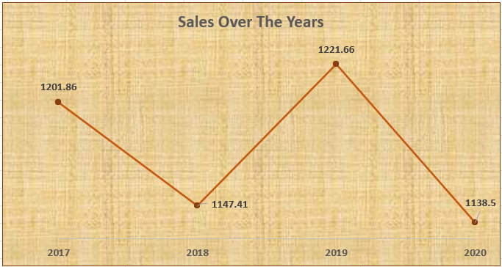
SALES OVER THE YEARS
Sales declined from 2017 to 2018, reaching a low point.
A sharp increase in sales occurred in 2019, peaking at the highest value.
A significant drop in sales is observed in 2020, indicating a downward trend.
The overall trend suggests volatility in sales performance over the four-year period.

Slide 12
TOP-SELLING TRACKS OVERVIEW
Insights:
The track "For Those About To Rock (We Salute You)" leads in sales by a large margin compared to all other tracks.
Other high-performing tracks include "Miracle," "Runnin' With The Devil," and "The Other Side," indicating strong listener preference.
A majority of the tracks fall into a moderate sales range, showing consistent but not outstanding performance.
Tracks like "Us And Them," "War Pigs," and "Little Dreamer" have relatively low sales, suggesting lesser popularity.
Overall, the data shows a clear gap between a few top-selling tracks and the rest, highlighting selective customer preferences.

Slide 13
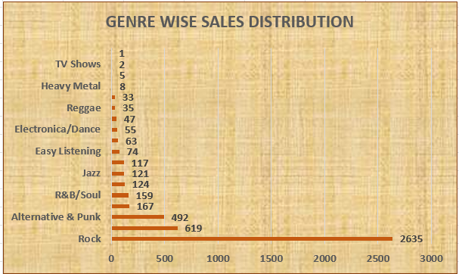
GENRE WISE SALES DISTRIBUTION
Key Insights:
Rock leads all genres with 2635 units sold — a clear customer favorite.
Alternative & Punk follows with 619 units, showing moderate popularity.
Mid-tier genres include R&B/Soul (159), Jazz (121), and Easy Listening (74).
Least sold genres are TV Shows (1) and Heavy Metal (5), indicating very low demand.
Sales distribution is highly skewed, with Rock dominating the market.

Slide 14
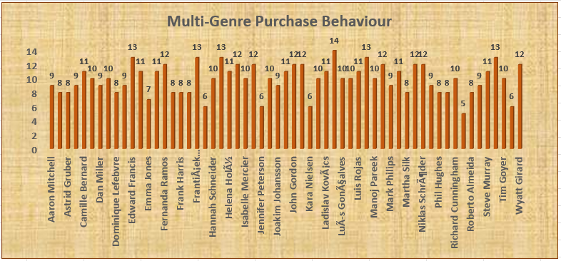
MULTI-GENRE PURCHASE BEHAVIOUR
Insights:
The chart shows multi-genre purchase behavior with Aaron Mitchell leading at 14 unique genres, followed closely by Astrid Gruber and Dominique Lefebvre at 13 genres each.
Most customers, including Frank Harris, Hannah Schneider, and João Fernandes, have purchased between 10 and 12 genres, indicating a broad range of preferences.
The lowest diversity is observed with Richard Cunningham and Steve Murray, each with 5 genres, while others like Wyatt Girard and Tim Grier range between 6 and 7 genres.
The average purchase behavior hovers around 10-11 genres, with a majority of customers showing consistent multi-genre engagement.

Slide 15
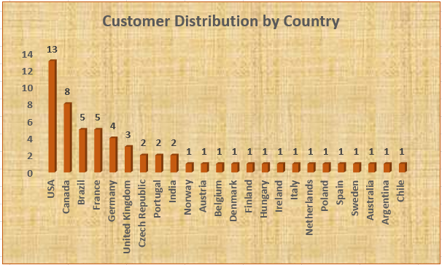
CUSTOMER DISTRIBUTION BY COUNTRY
Insights:
The USA has the highest customer distribution with 13 customers, followed by Canada with 8, indicating a strong presence in North America.
France and Germany each have 5 customers, while the United Kingdom and Czech Republic have 4 and 3 respectively, showing moderate distribution in Europe.
Most other countries, including India, Norway, Austria, Belgium, Denmark, Finland, Hungary, Ireland, Italy, Netherlands, Poland, Spain, Sweden, Australia, Argentina, and Chile, have a low customer count of 1 or 2 each.
The data suggests a significant concentration of customers in a few countries, with the majority of nations having minimal representation.

Slide 16
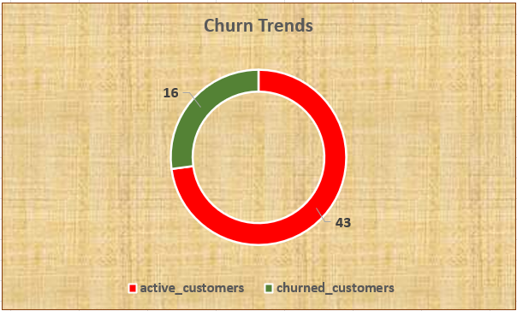
CHURN TRNDS ANALYSIS
Insights:
The chart shows a high churn rate with 43 churned customers compared to 16 active customers, indicating significant customer loss.
Approximately 73% of the customer base is churned, suggesting a critical retention challenge.
The remaining 27% active customers highlight a need for immediate action to prevent further decline.
Recommendations:
Implement targeted retention campaigns to re-engage the 43 churned customers.
Enhance customer support and engagement strategies to sustain the 16 active customers.

Slide 17
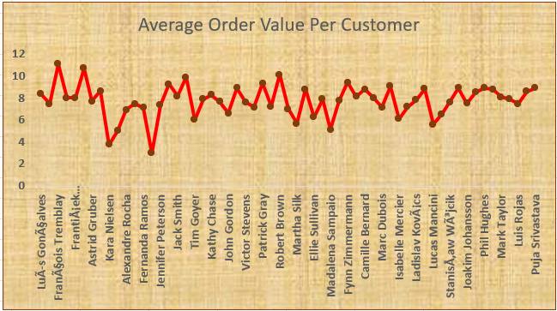
PER-CUSTOMER AVERAGE ORDER VALUE
Insights:
Luis Gonçalves and François Tremblay lead with average order values around 10-12 units, indicating higher spending.
Most customers, including Jennifer Peterson and Victor Stevens, show values between 6 and 8 units, reflecting moderate spending patterns.
Mark Taylor and Puja Srivastava have the lowest values at 4-6 units, suggesting lower engagement or smaller orders.
The data highlights a wide variation in average order values across the customer base.

Slide 18

STRATEGIC RECOMMENDATIONS FOR GROWTH
Re-engage Churned Customers:
Launch email or discount campaigns to win back the churned customers and understand drop-off reasons.
Boost Low Spenders:
Offer targeted promotions or bundles to customers with low average order values to increase their spend.
Reward Top Customers:
Introduce loyalty perks or VIP benefits for high-value customers to drive retention and repeat purchases.
Segment & Personalize
Use customer behavior data to segment users and run personalized marketing for better engagement and conversion.

Slide 19

CONCLUSION
Genre Popularity Trends:
Rock and Metal consistently outperform other genres, signaling strong audience preference and promotional potential.
Regional Personalization Needs:
A one-size-fits-all approach is ineffective—personalized, country-specific marketing is vital to boost loyalty and market share.
Churn Hotspots:
Countries like Germany and Norway reflect higher churn, suggesting a need for localized retention strategies.
Customer Activity Gaps:
A notable portion of the customer base remains inactive, underlining the importance of timely engagement and follow-up.
Loyalty Weaknesses:
High-value customers are not being retained effectively, pointing to gaps in reward systems and long-term engagement.
Revenue Concentration:
The bulk of revenue originates from USA, Brazil, and Canada, making them key focus areas for future campaigns.

Slide 20
THANK YOU

